Slide 1

An Najah Rank
Software Graduation Project

Slide 2



Our Team
Supervisor
Dr. Samer Arandi
Momen Odeh
Noor Aldeen
Abu Shehadeh

Slide 3
Table of contents
01
Problem Statement
02
Our Solution
03
Features
04
Methodology
05
Challenges and Constraints
06
Future Work

Slide 4

What ‘s the problem?
The problem-solving skills are one of the most important skills in the workplace.
An-Najah University strives to improve these skills in our students.
Problem solving websites lack essential features that would simplify the problem-solving process and make solution grading more efficient.

Slide 5
Our Solution
We built An Najah Rank, a problem-solving web application that combines solving problems for students and adds the educational features needed for professors, making the process more simple.

Slide 6



Who use web application ?
Professors
Students
Admin

Slide 7
Features
01
02
03
Registration & login
Admin
Course Management
04
05
06
Manage test cases of Challenge
Code operation
Similarity
07
08
09
Track submissions
Manual Mark
Chatting & Notification

Slide 8

Methodology
Software Development Life Cycle:

Slide 9
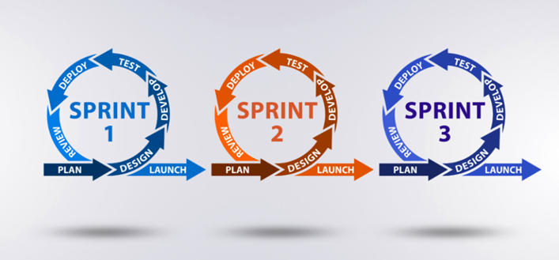
Methodology (cont.)
Agile Methodology:

Slide 10

Planning Phase
We met with our supervisor Dr. Samer Arandi.
We explored various problem-solving websites.
We are discussing new functionalities to add to the project.

Slide 11

Analysis Phase
Gathering and documenting requirements.
Writing user stories to clearly outline specific functionalities.
Envisioning the system's architecture using Unified Modeling Language (UML) diagrams.

Slide 12
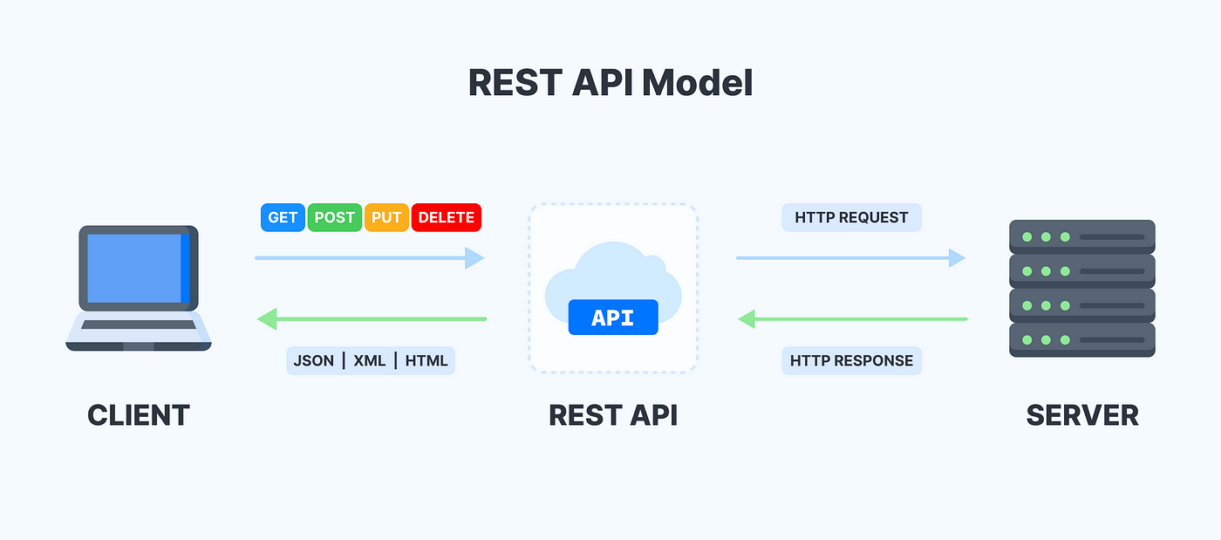
Design Phase
Architectural Style:

Slide 13
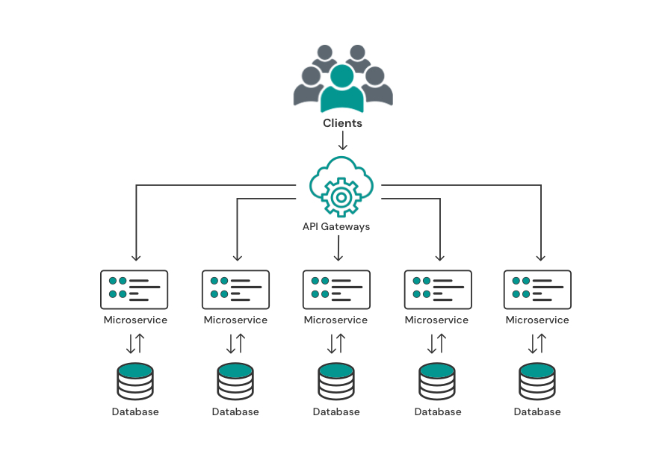
Design Phase (cont.)
Architectural Pattern:
Microservice Architectural pattern

Slide 14








Design Phase (cont.)
Frontend libraries:
Backend technologies :

Slide 15







Design Phase (cont.)
DevOps tools:
AWS Cloud Formation:

Slide 16
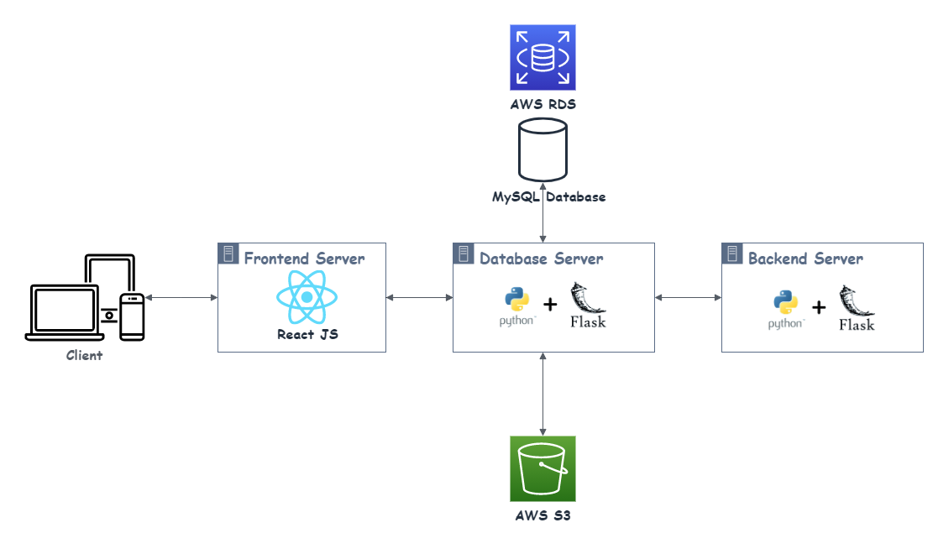
Design Phase (cont.)
Project Structure:

Slide 17




Security
Authentication: verifying a user or device before allowing access to web application.
Authorization: giving the user permission to access a specific page.
CORS policies: a mechanism that allows restricted resources on a web page to be accessed from another domain outside the domain from which the first resource
Library used:

Slide 18
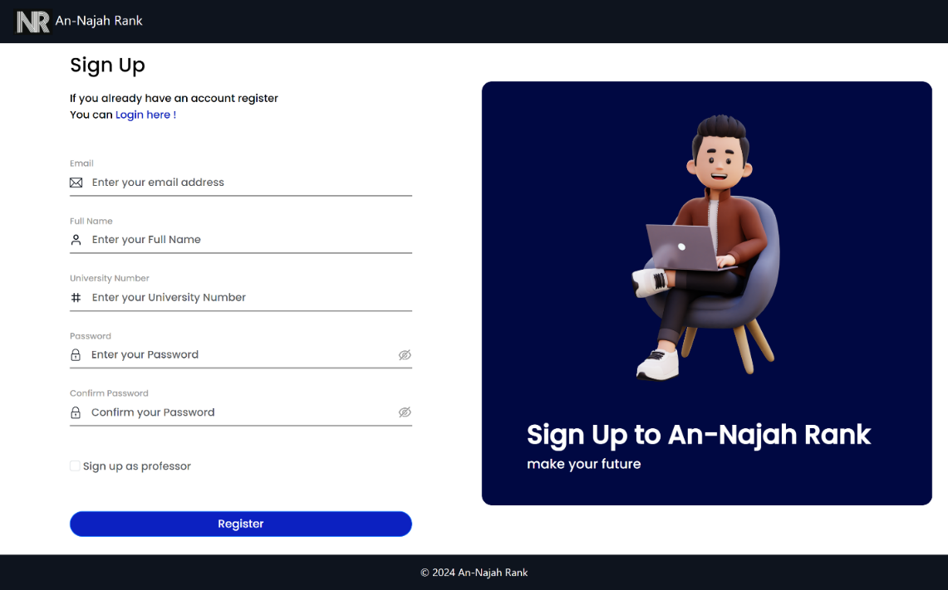
User Features
Registration:

Slide 19
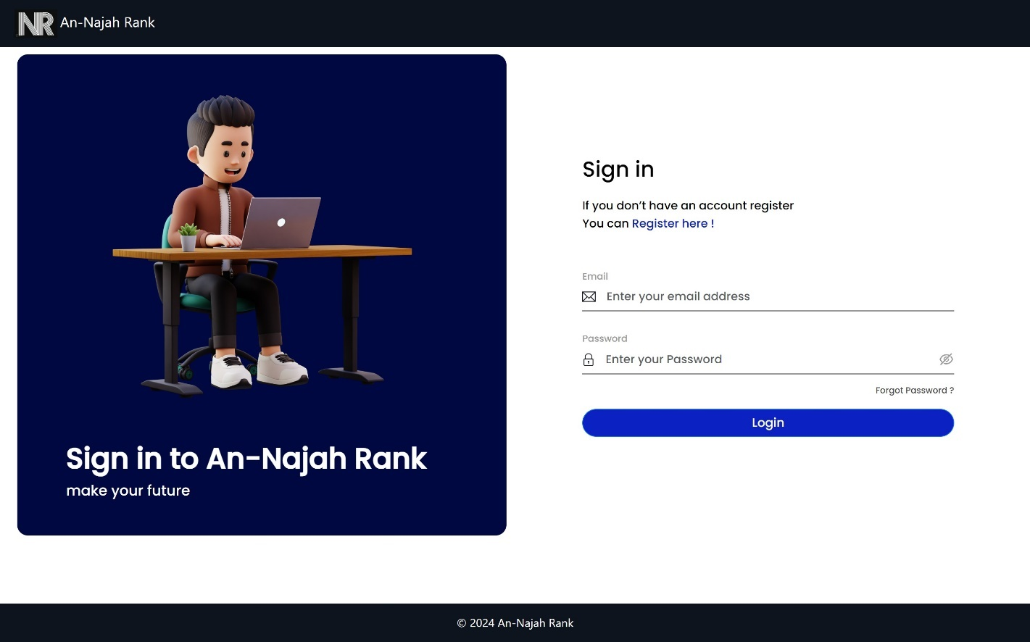
User Features
Sign in:

Slide 20
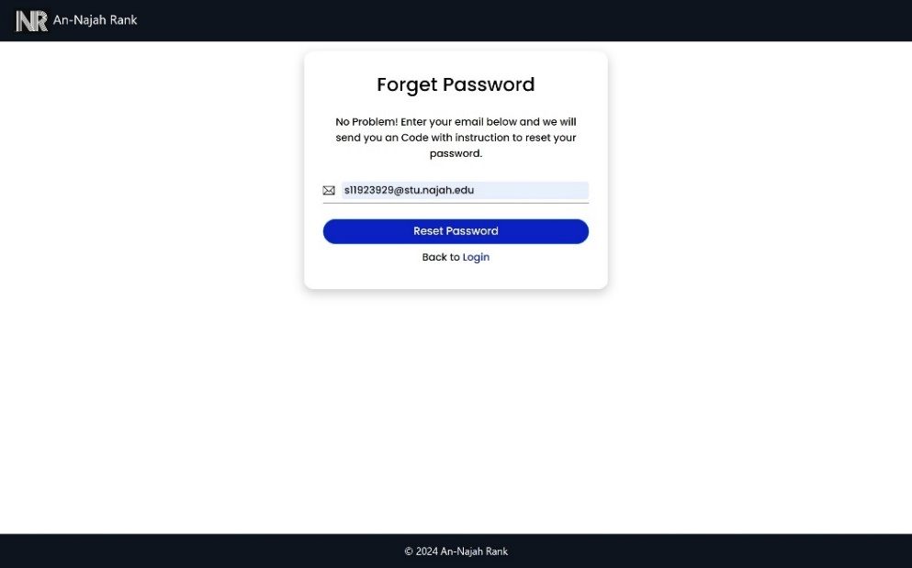
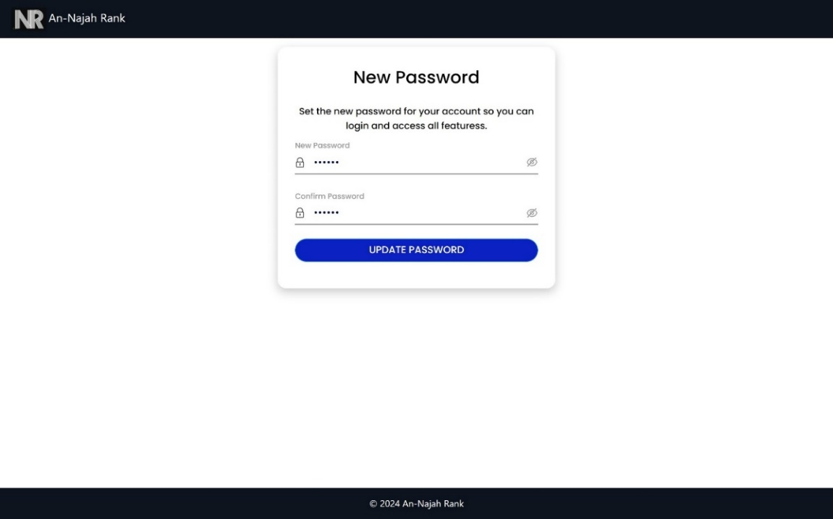
User Features
Forget password:

Slide 21
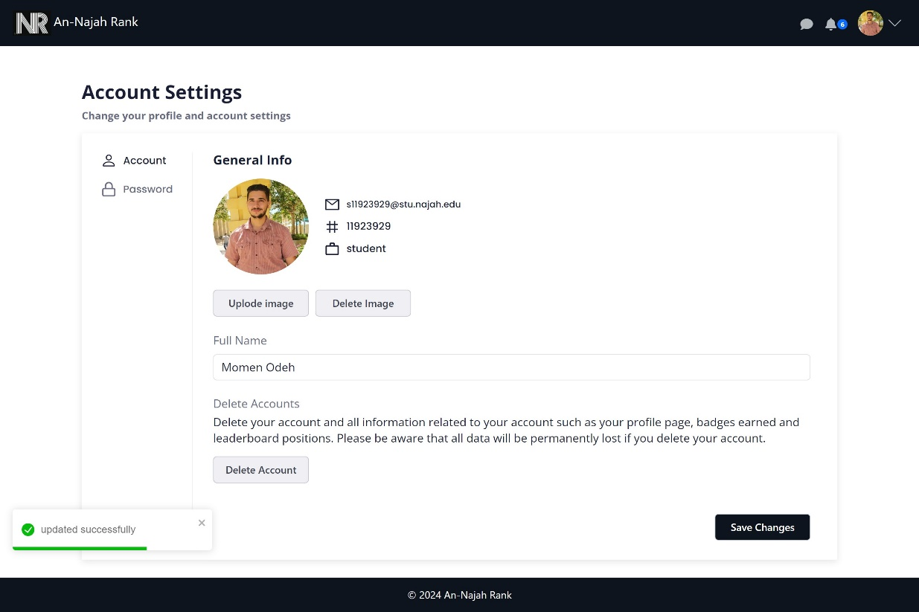
User Features
Account Settings:

Slide 22
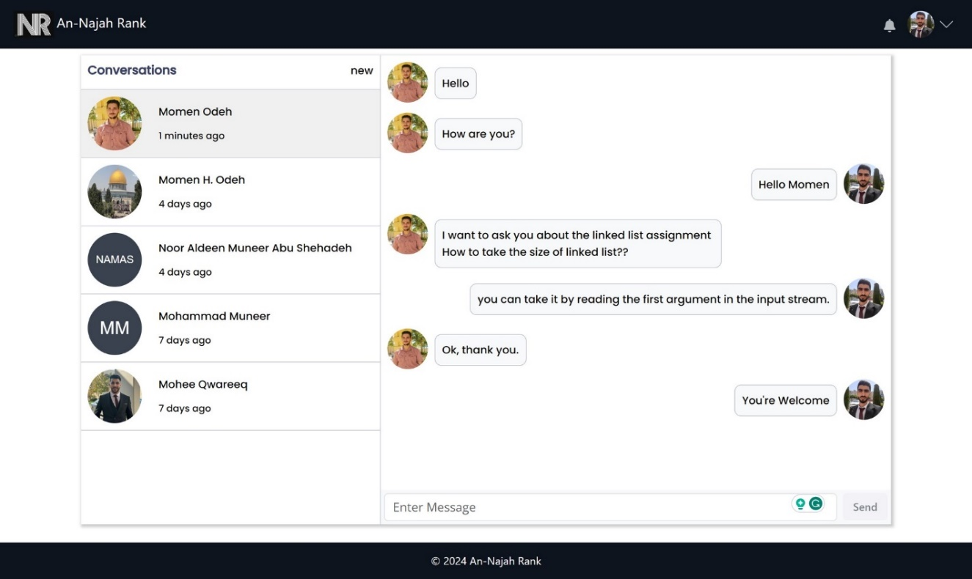
User Features
Chatting:

Slide 23
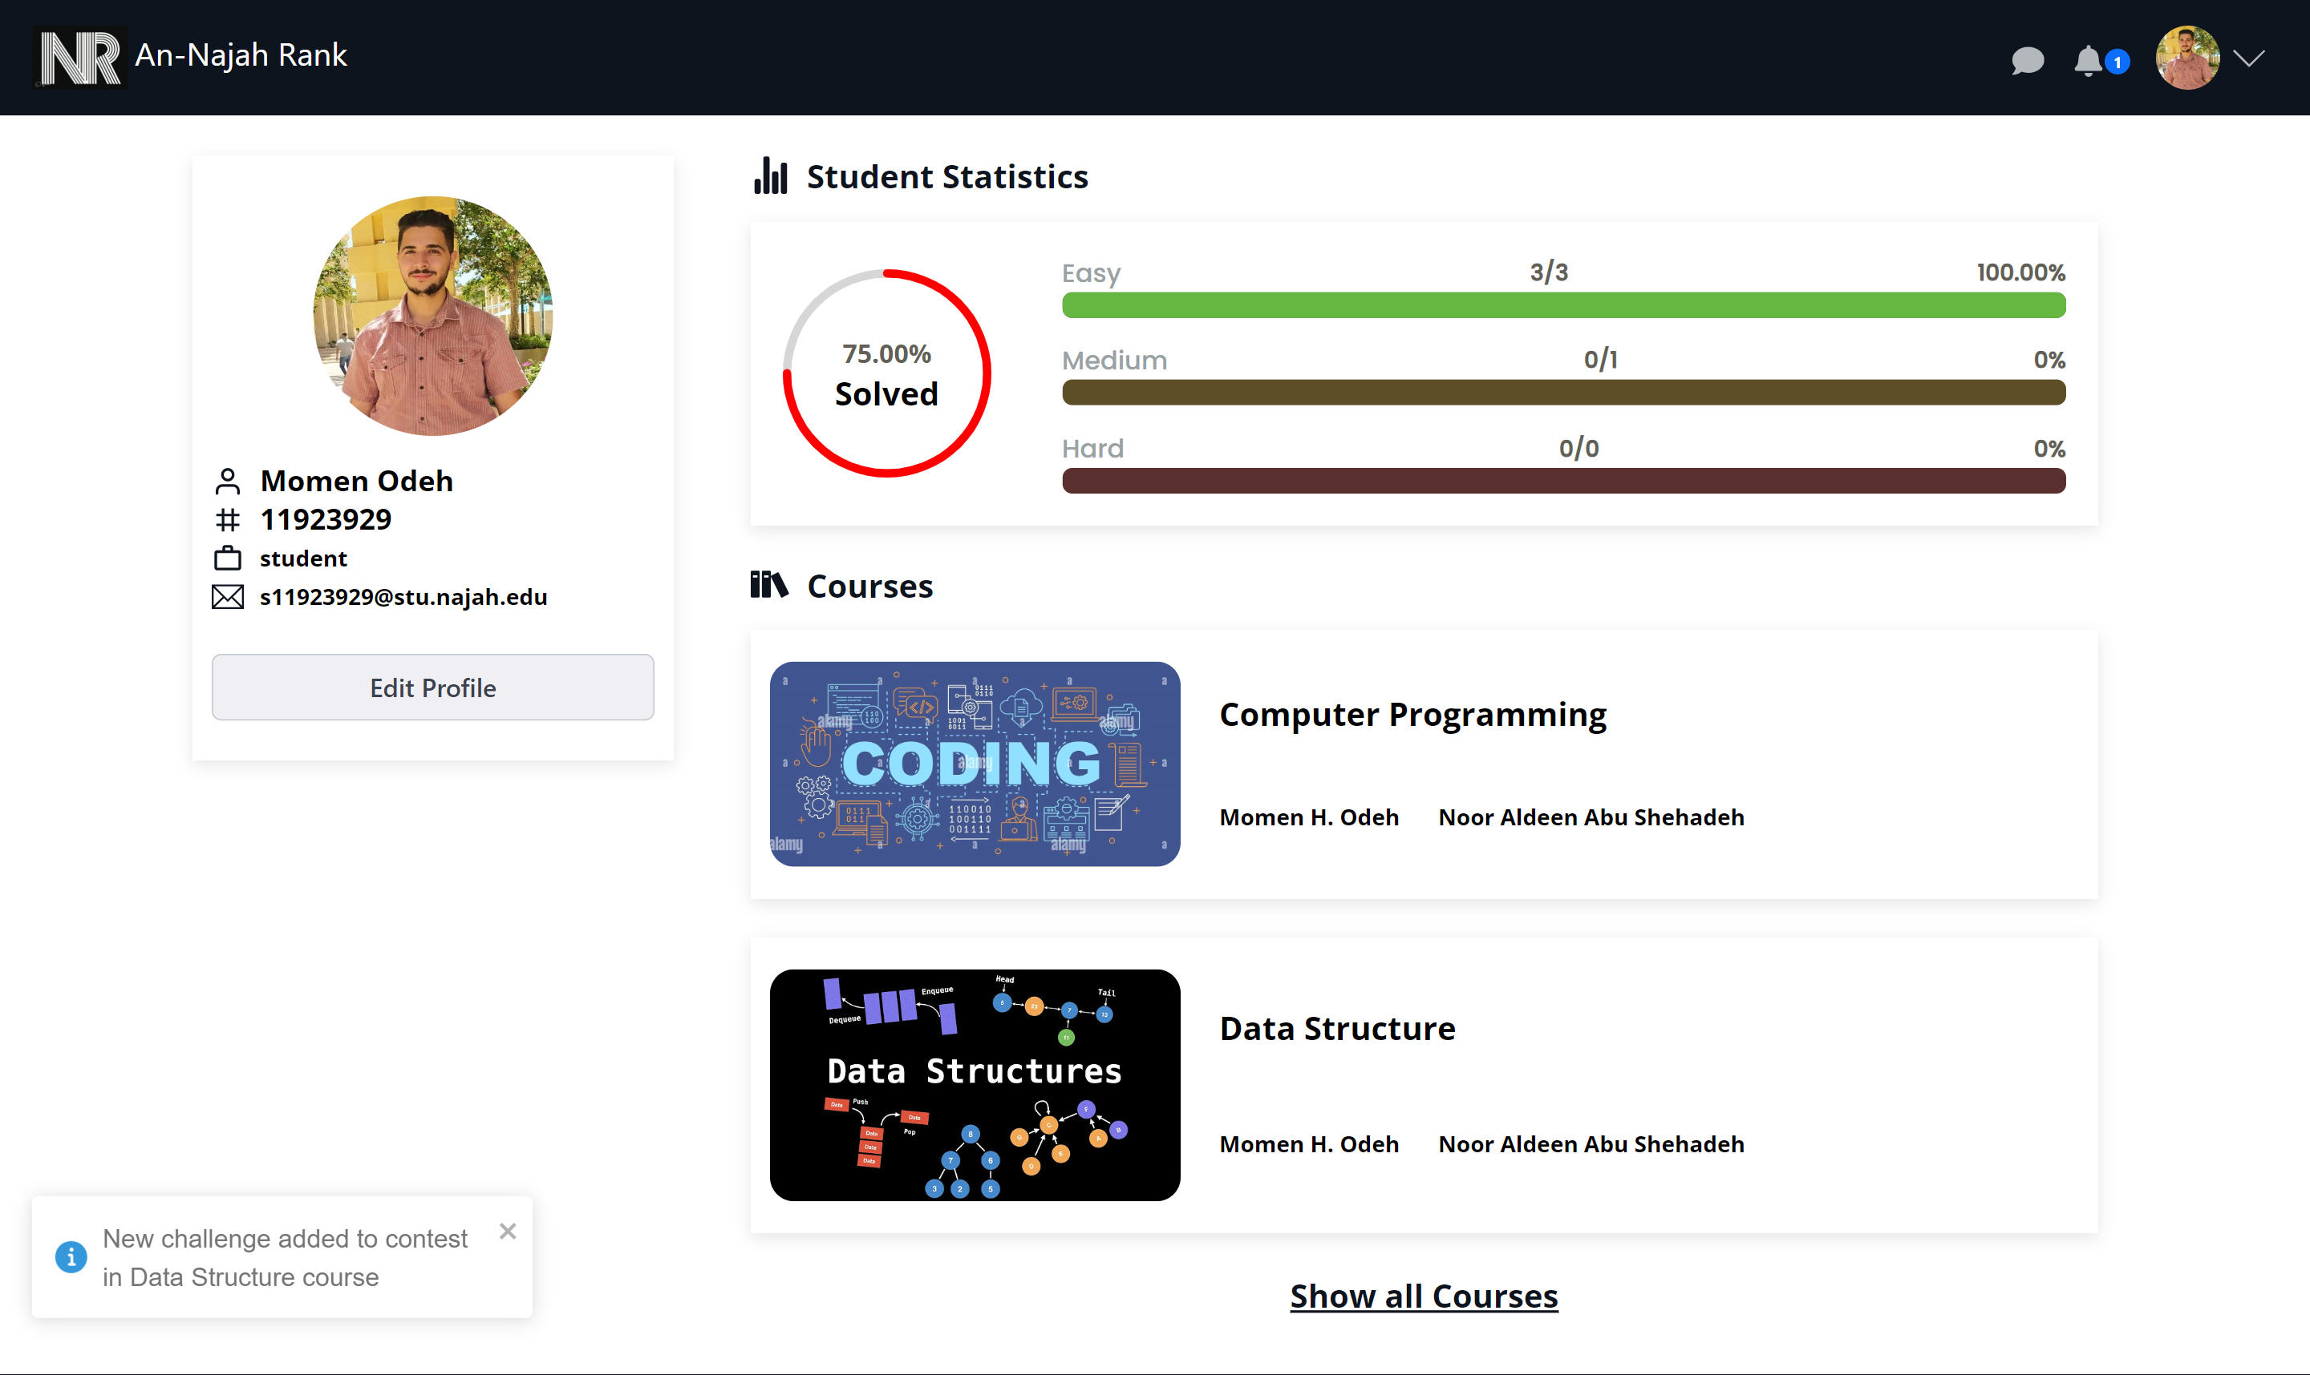
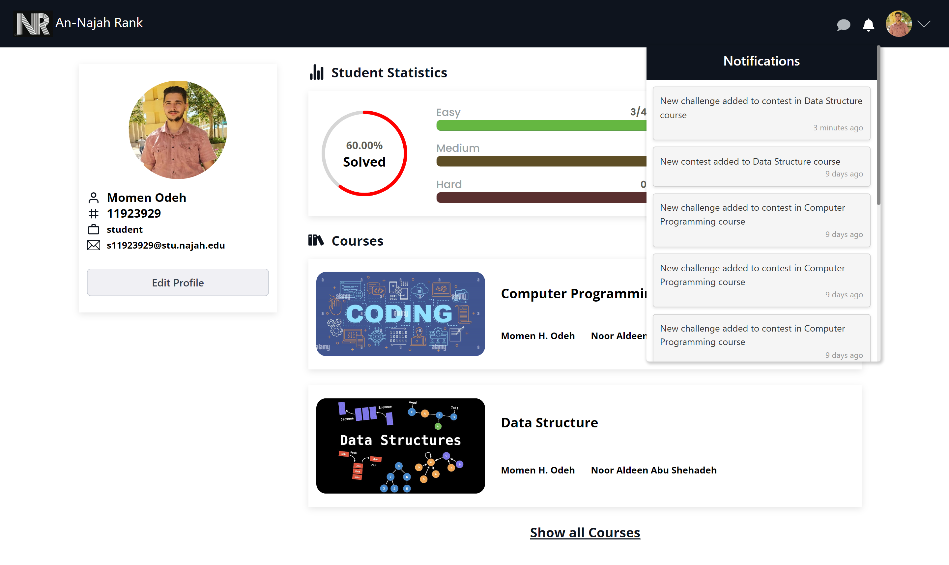
User Features
Notifications:

Slide 24
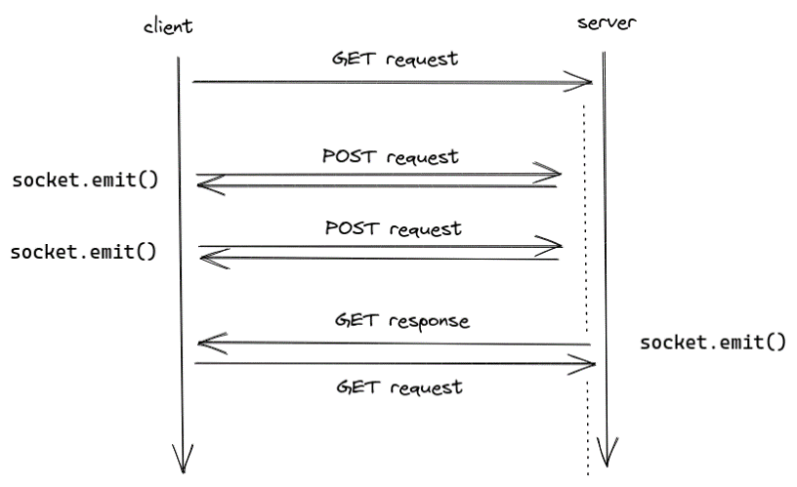
Socket IO:

Slide 25
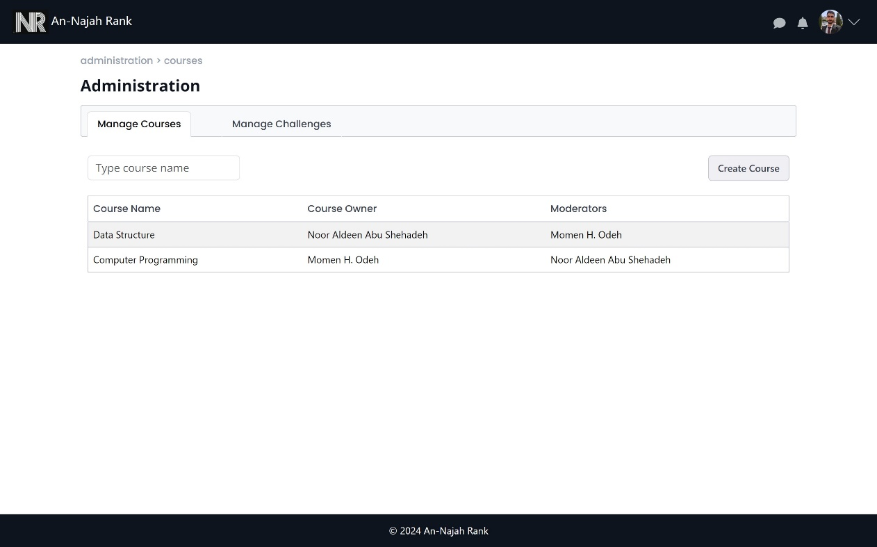
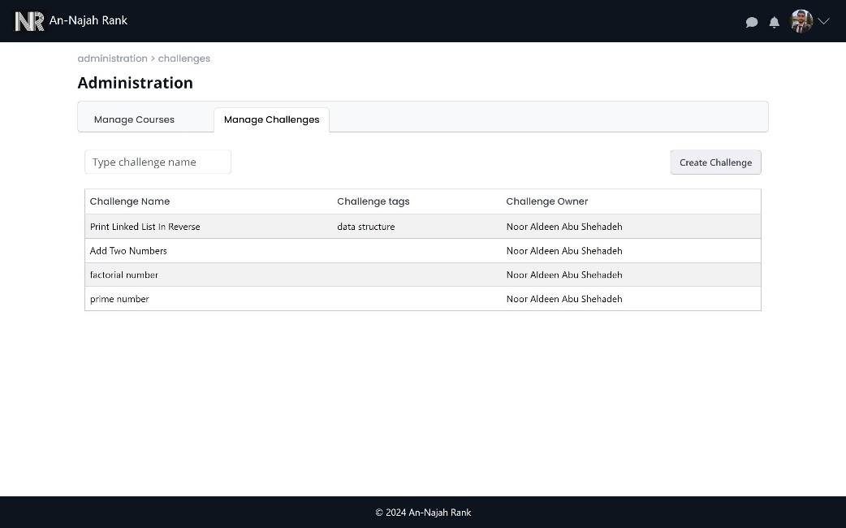
Professor Features
Mange Courses
Mange Challenges

Slide 26
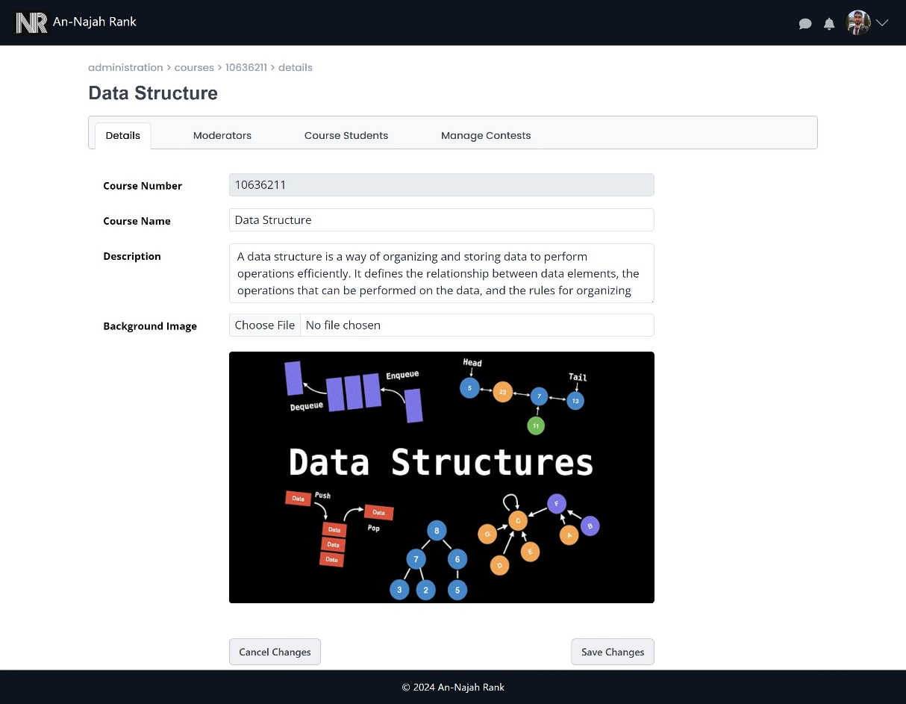
Professor Features (cont.)
Course Management:

Slide 27
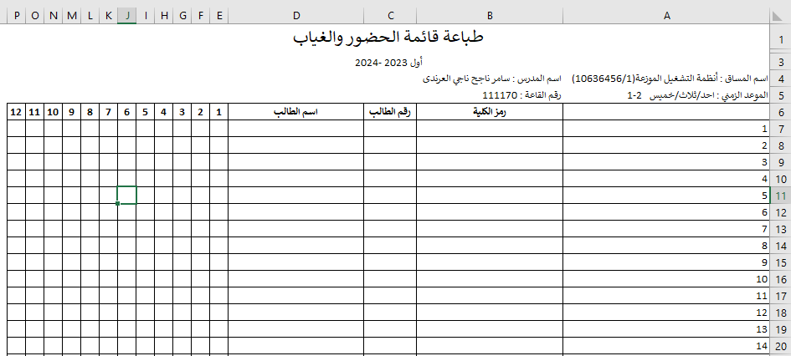
Professor Features (cont.)
Add students to course

Slide 28
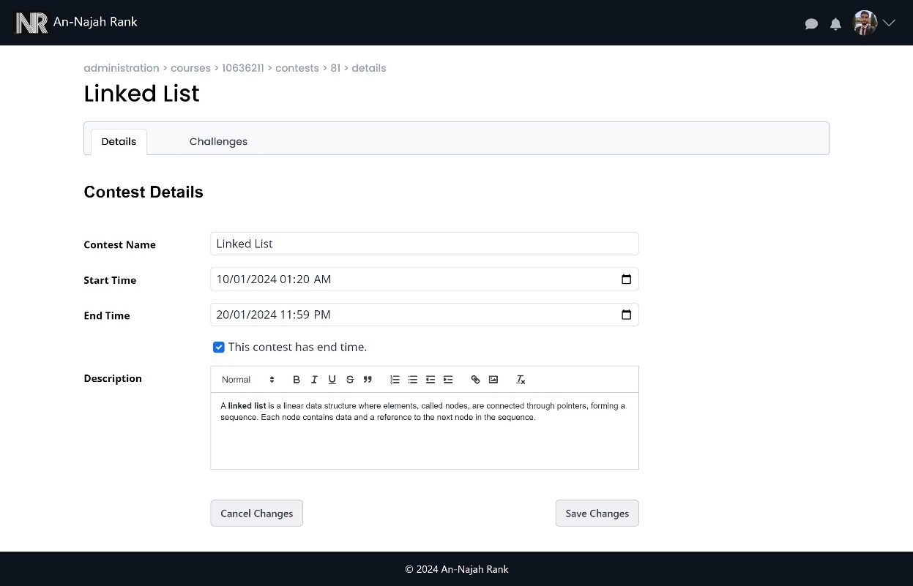
Professor Features (cont.)
Contest Management :

Slide 29
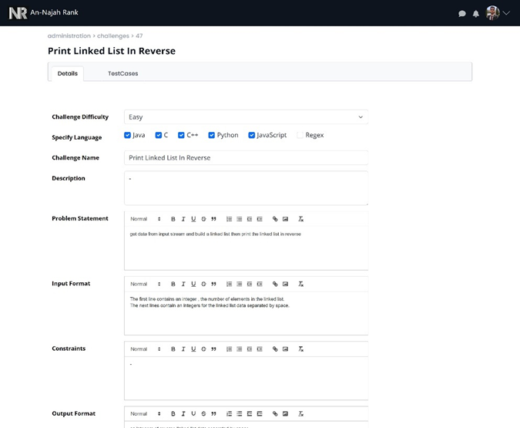
Professor Features (cont.)
Challenge Management :

Slide 30
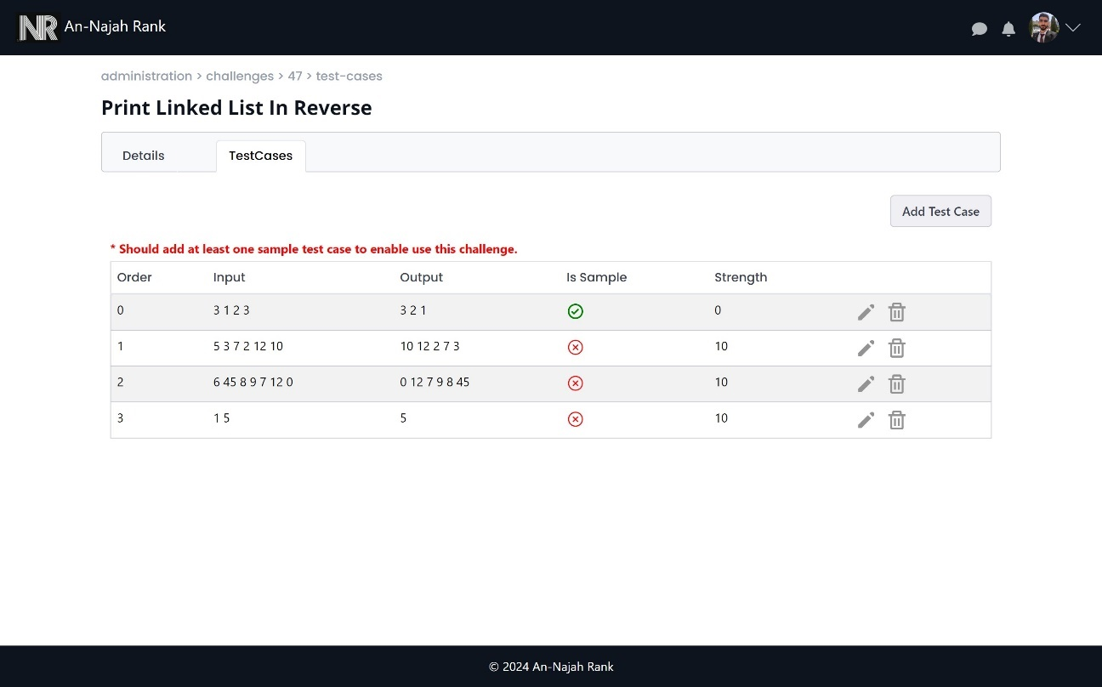
Professor Features (cont.)
Manage test cases in challenge

Slide 31
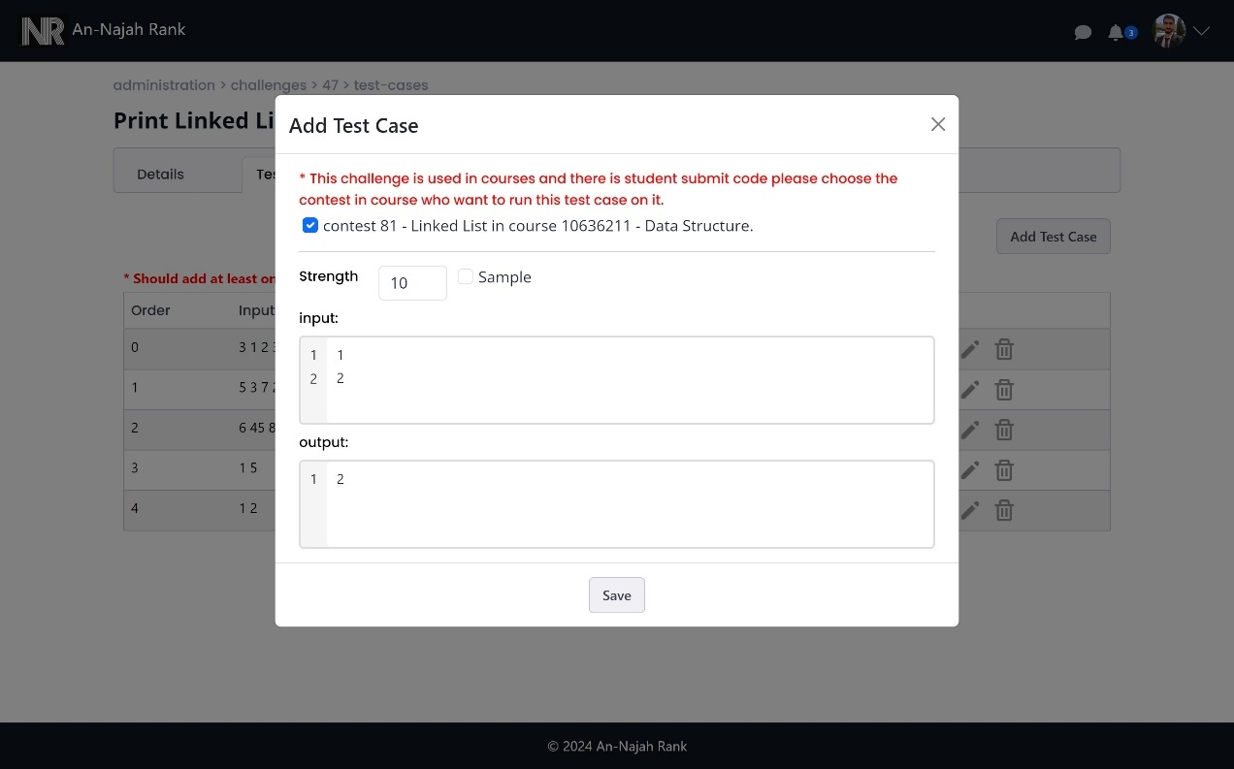
Professor Features (cont.)
Add new test case when there is a submission for challenge

Slide 32
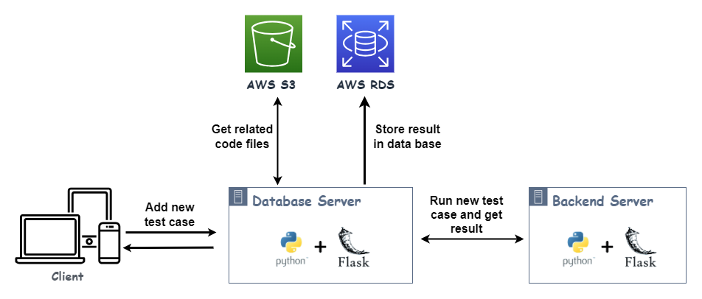
Add new test case when there is a submission for challenge (cont.)

Slide 33
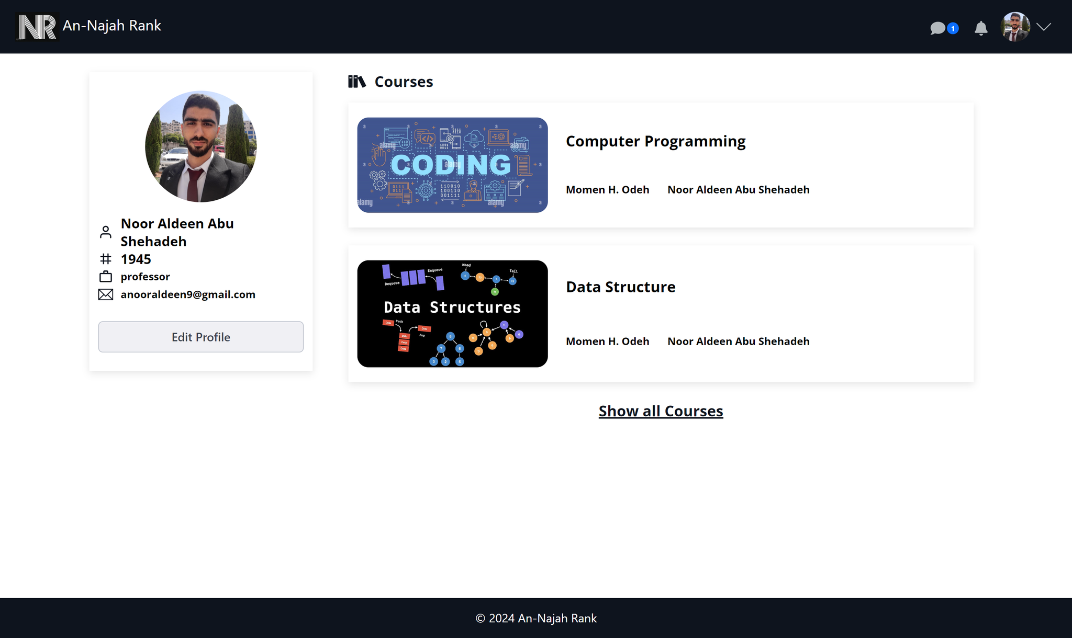
Professor Features (cont.)
Profile:

Slide 34
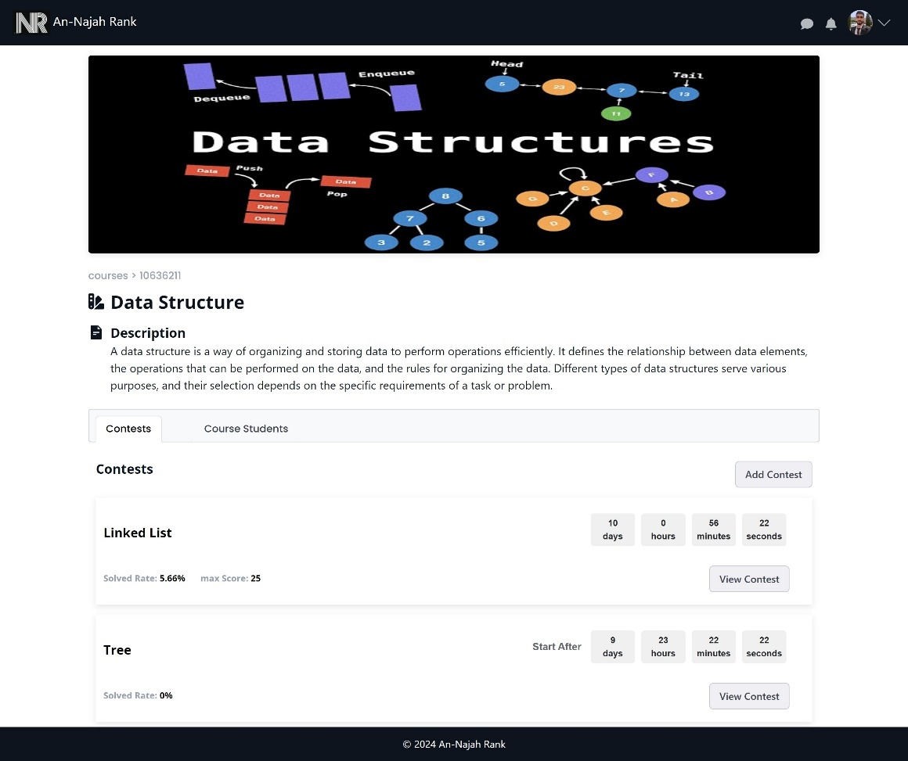
Professor Features (cont.)
Course View:

Slide 35
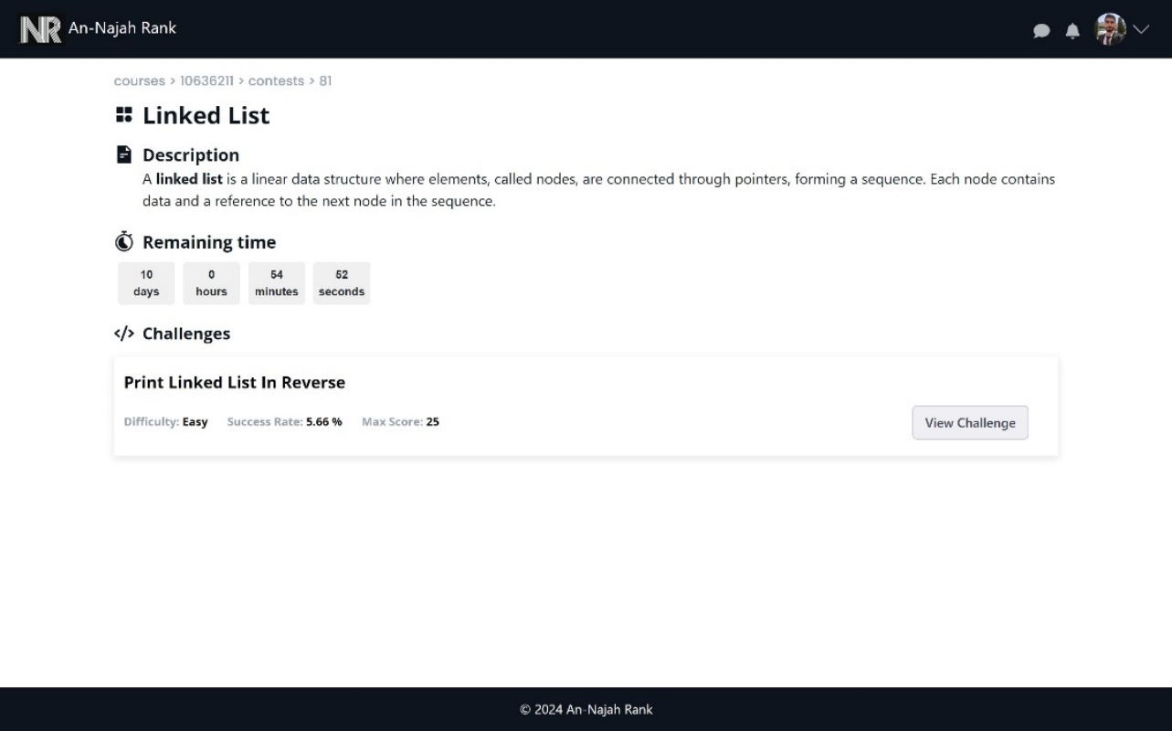
Professor Features (cont.)
Contest View:

Slide 36
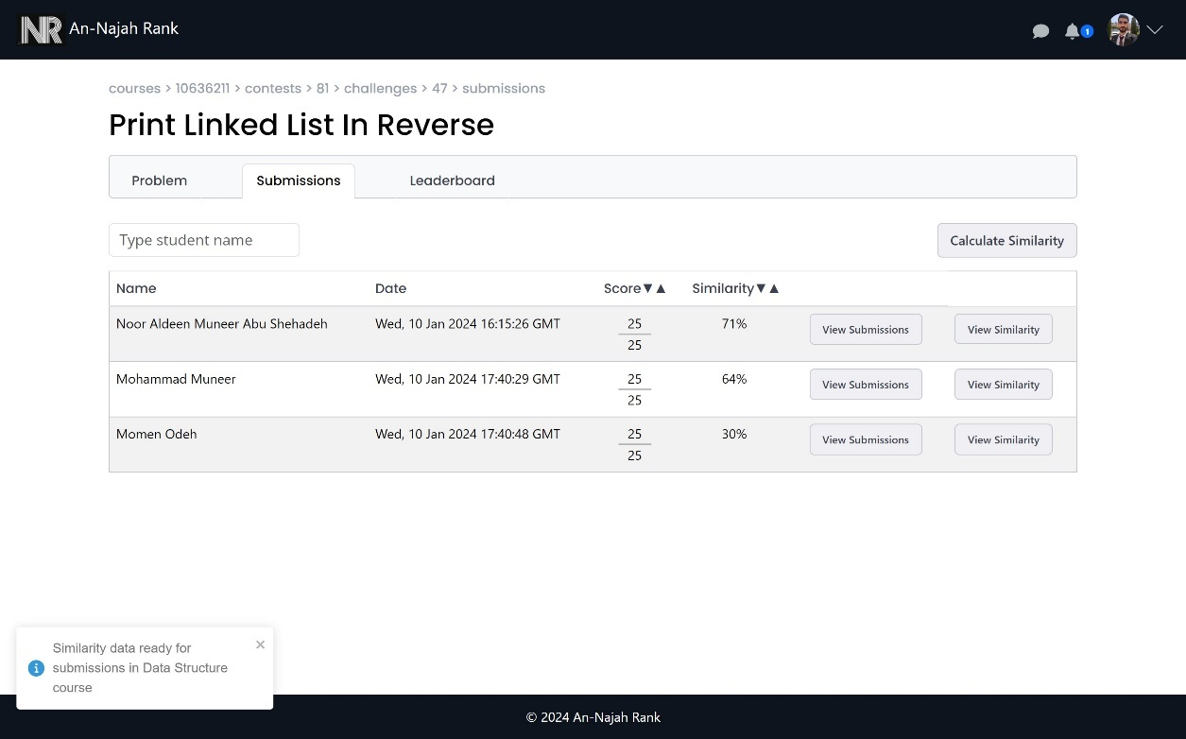
Professor Features (cont.)
Challenge submission View:

Slide 37
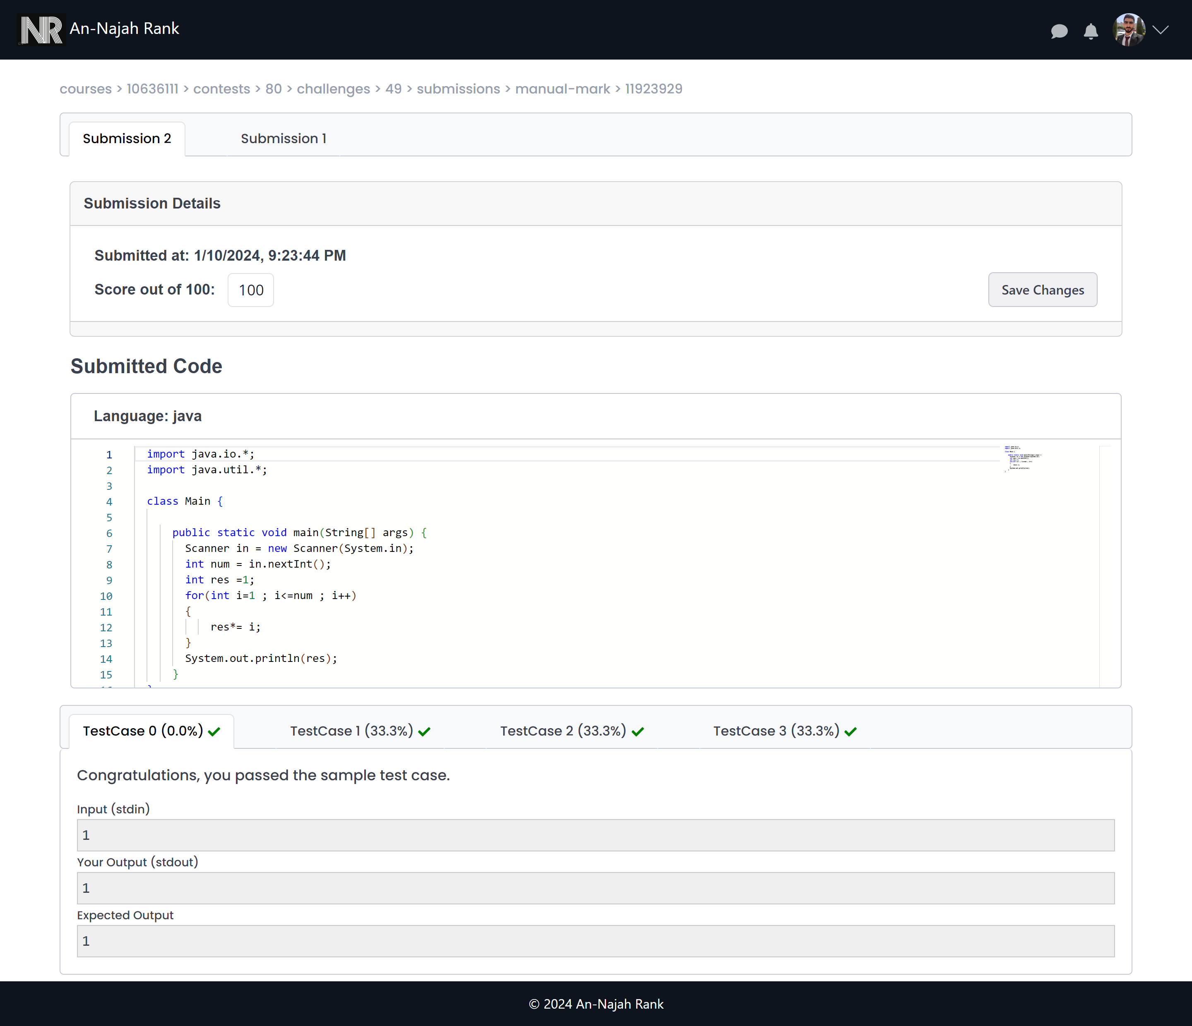
Professor Features (cont.)
Challenge student submissions View:

Slide 38
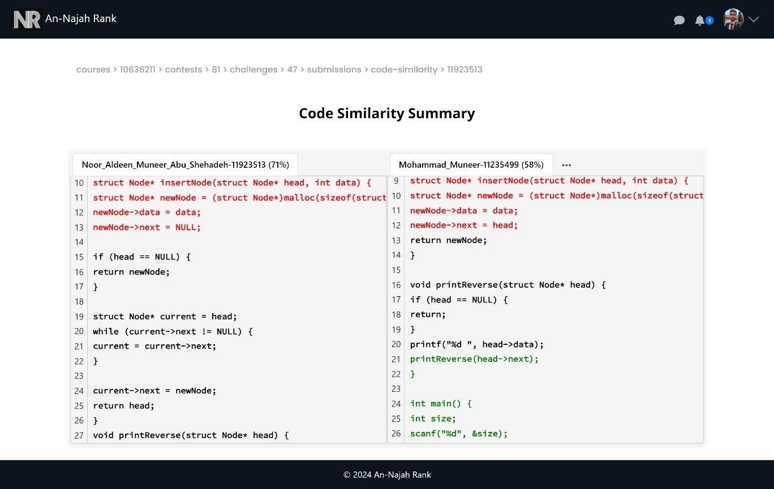
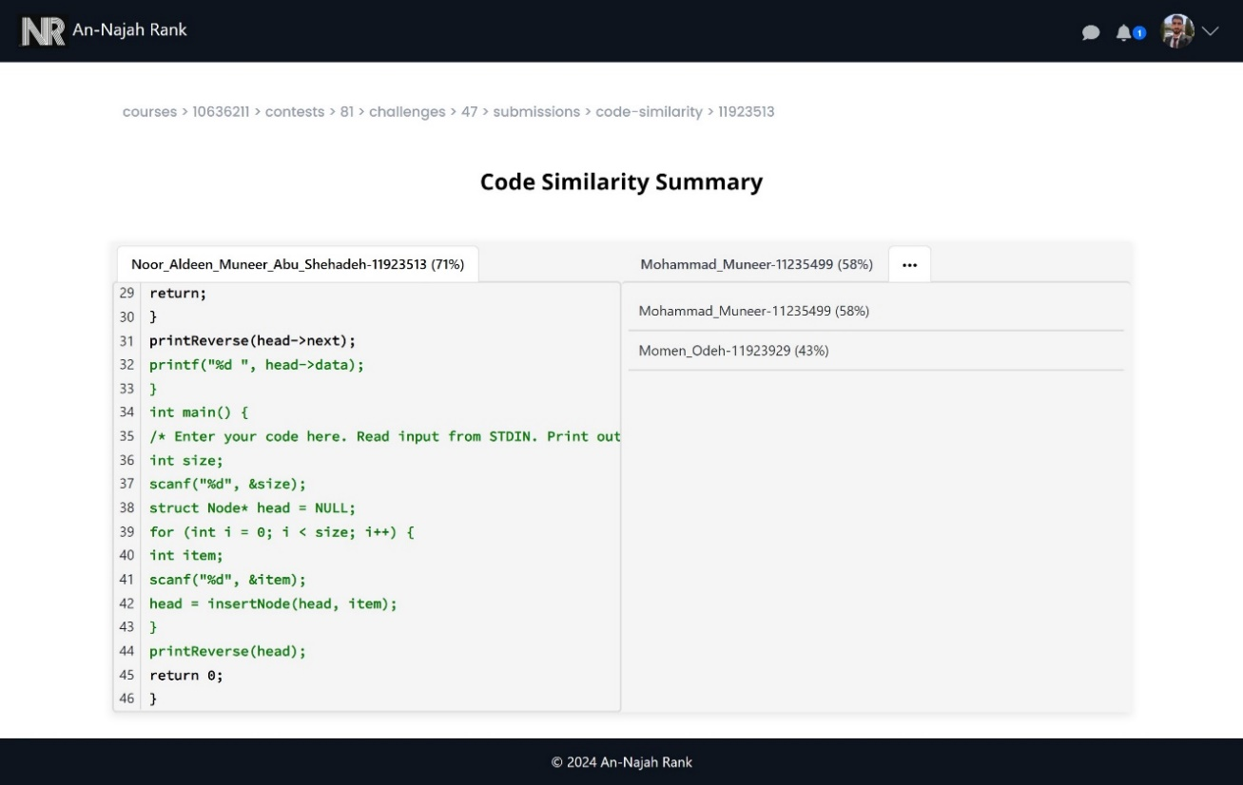
Professor Features (cont.)
Challenge student similarity View:

Slide 39
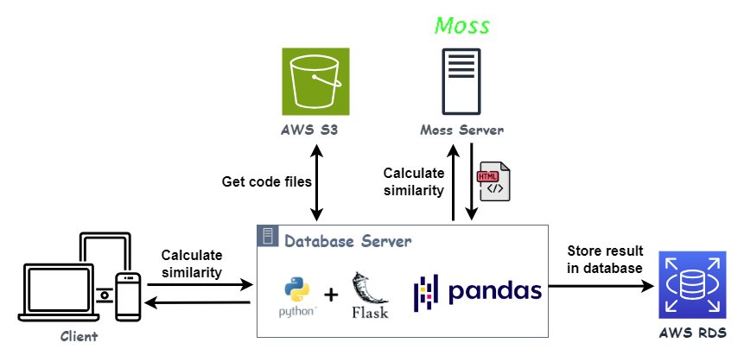
Challenge student similarity View (cont.):

Slide 40
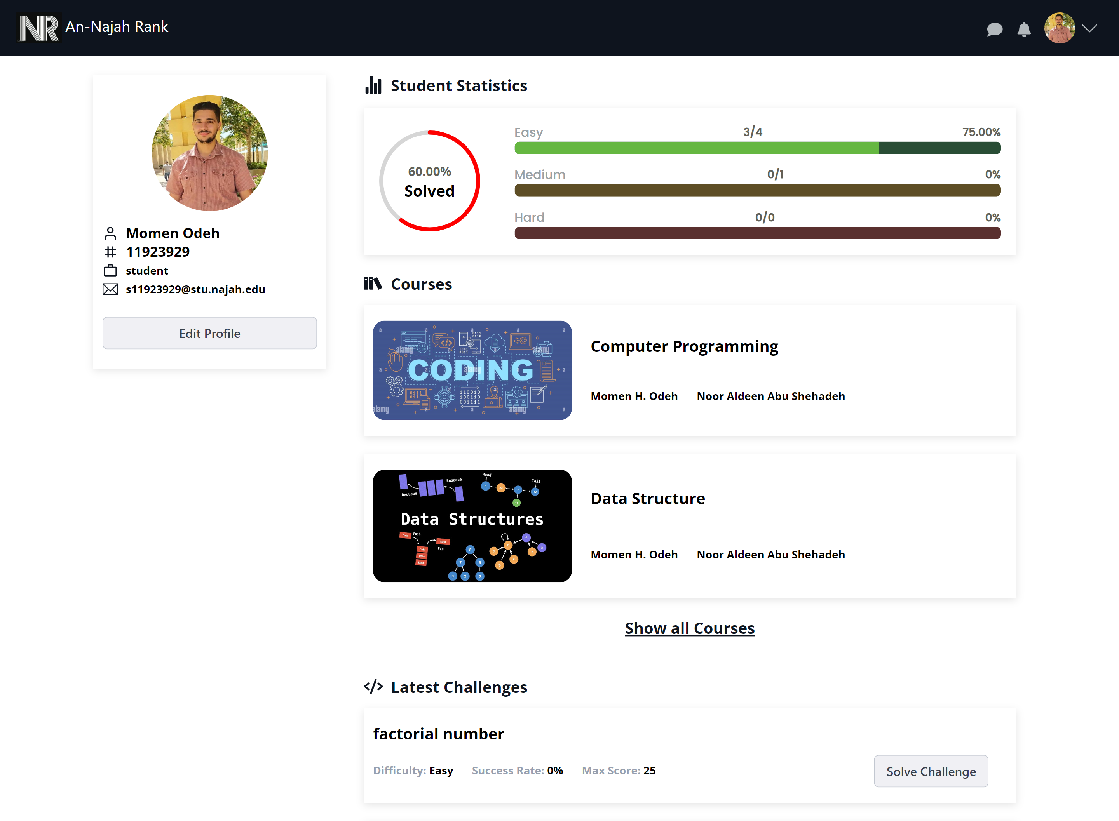
Student Features
Student Profile:

Slide 41
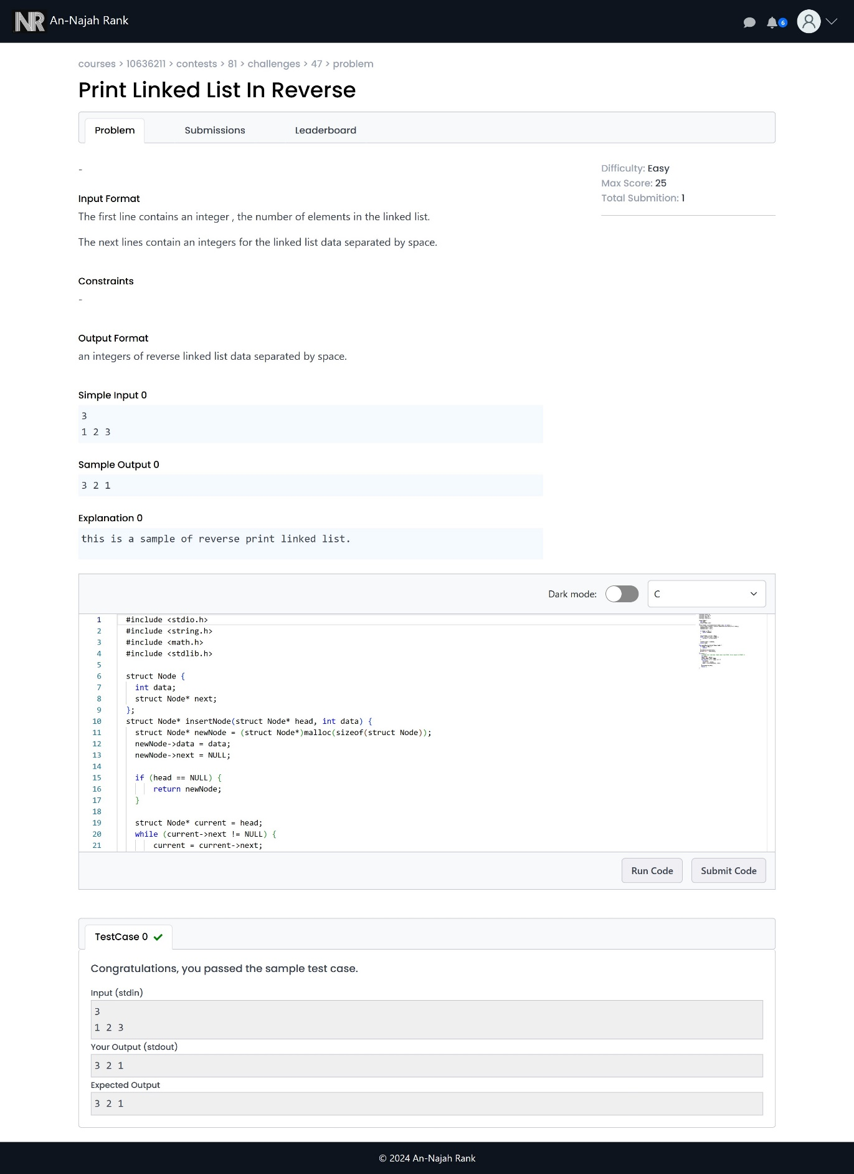
Student Features
Solving challenge:

Slide 42
Code operation:

Slide 43
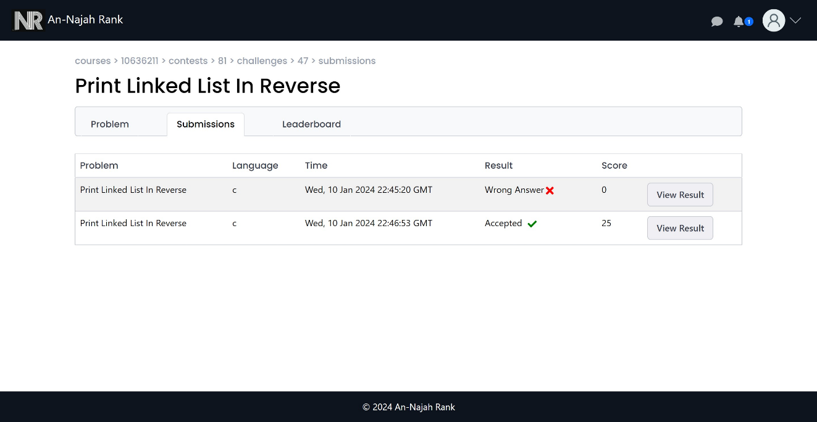
Student Features
Student submission:

Slide 44
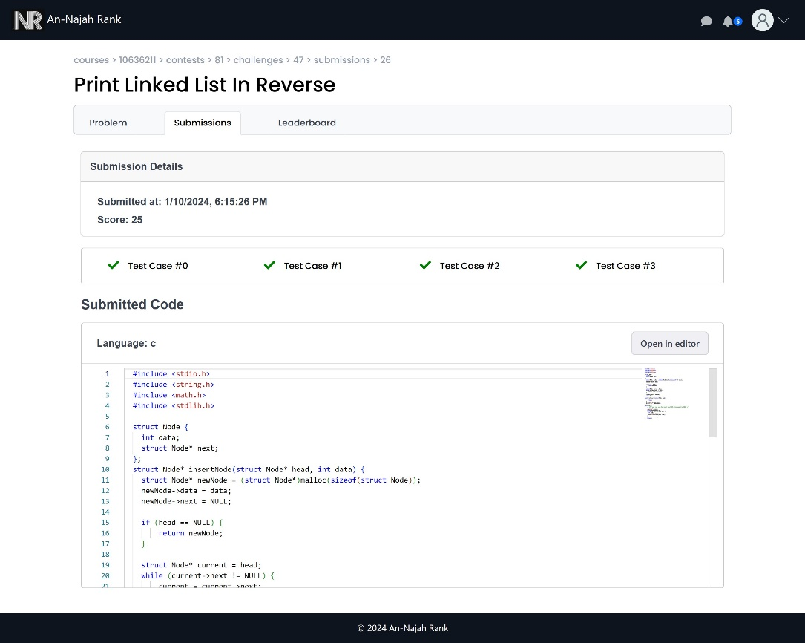
Student Features
Student submission (cont.):

Slide 45
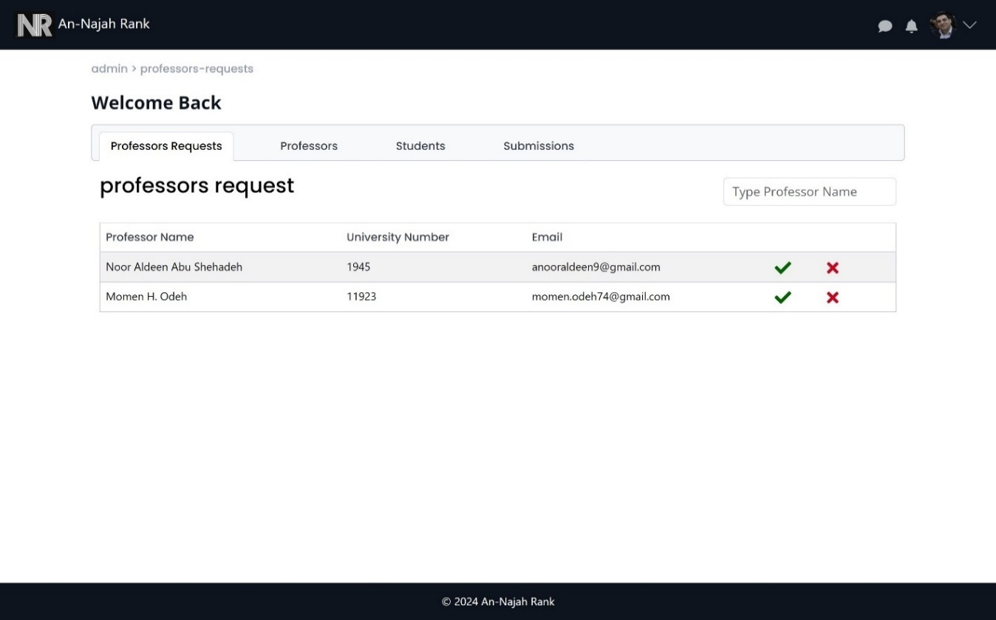
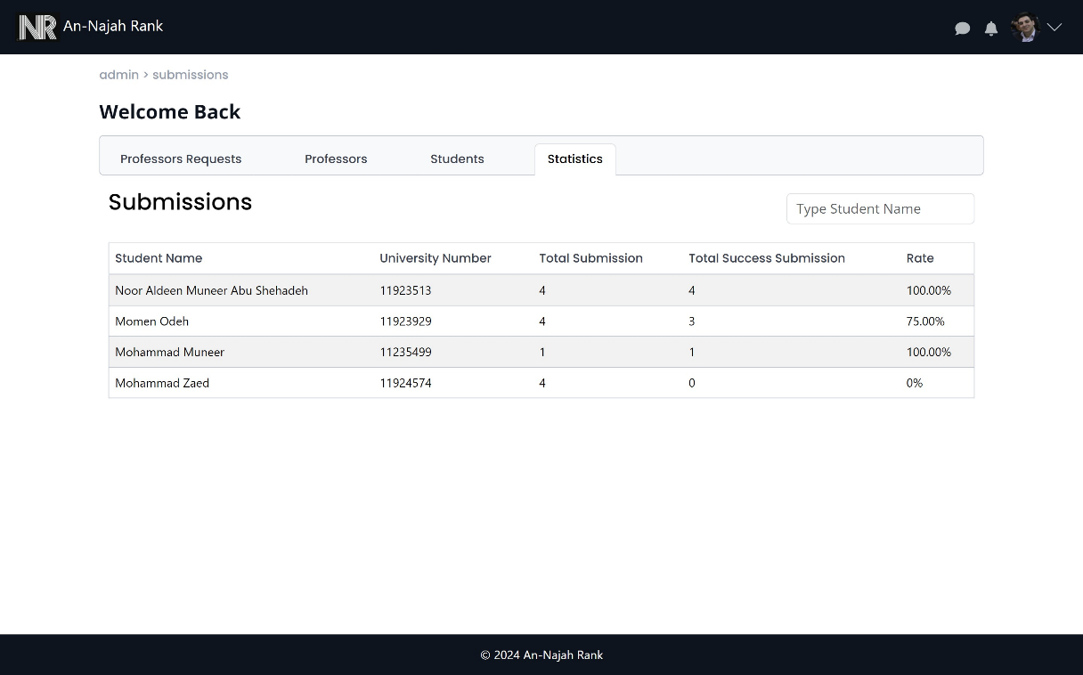
Admin Features
pending professors
Students statistics

Slide 46
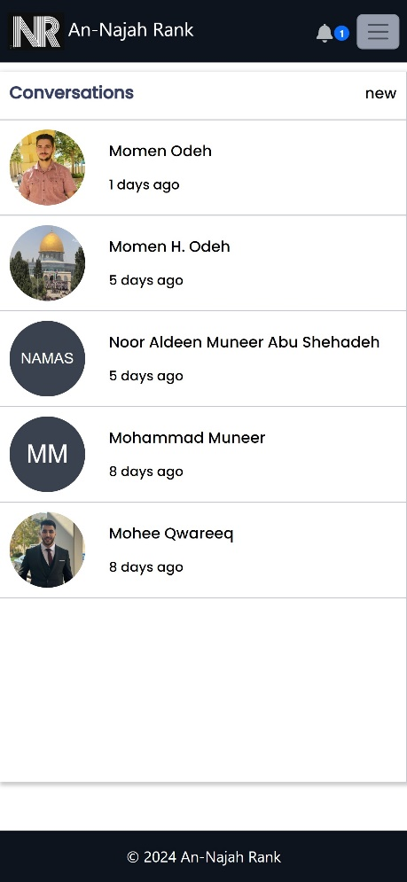
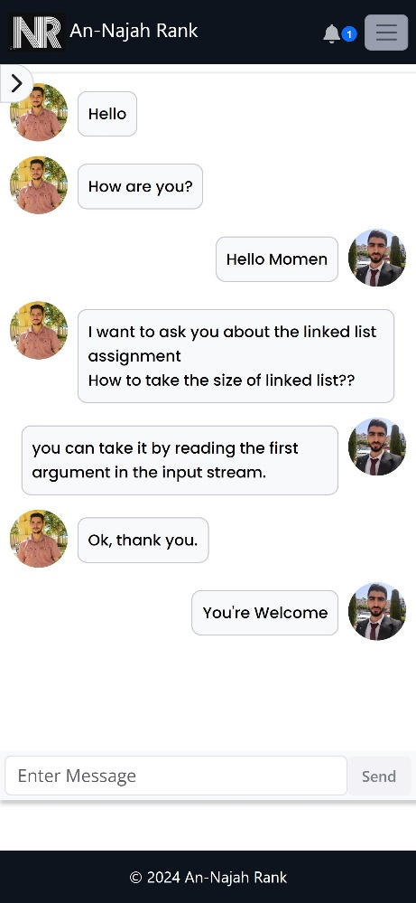
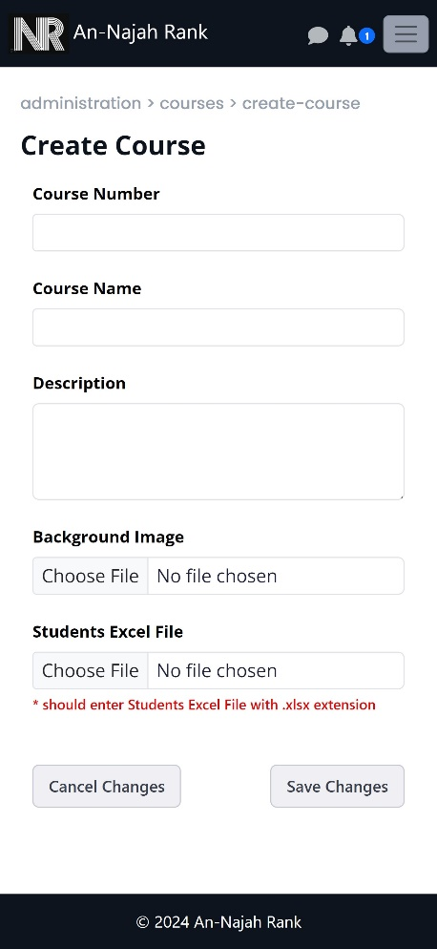

Sample of responsive design

Slide 47
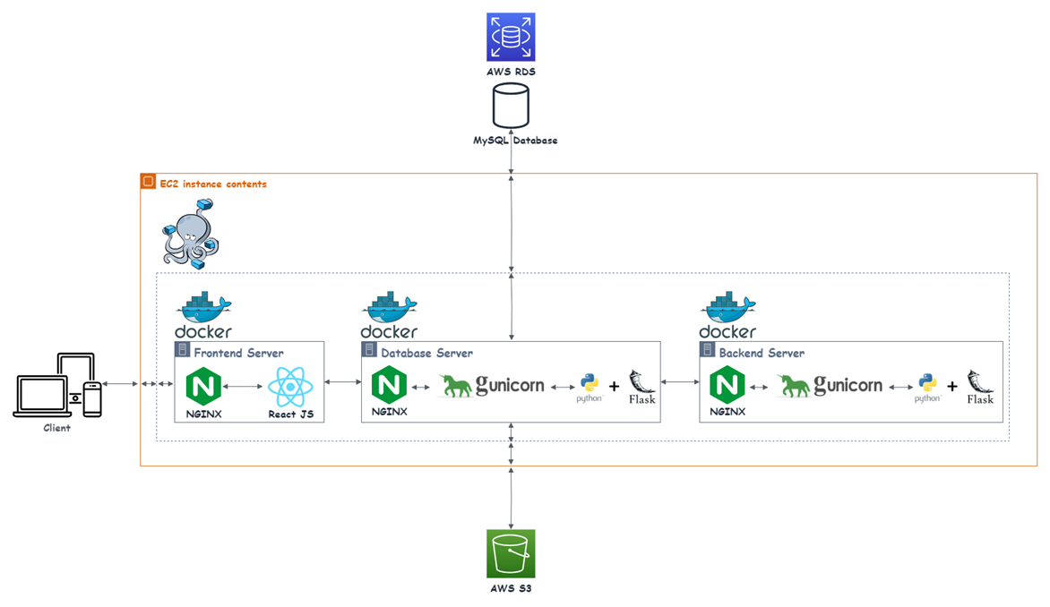
Deployment Phase

Slide 48

Testing Phase
After implementing the project, we conduct manual testing for all features in the system to ensure that all features work correctly.

Slide 49
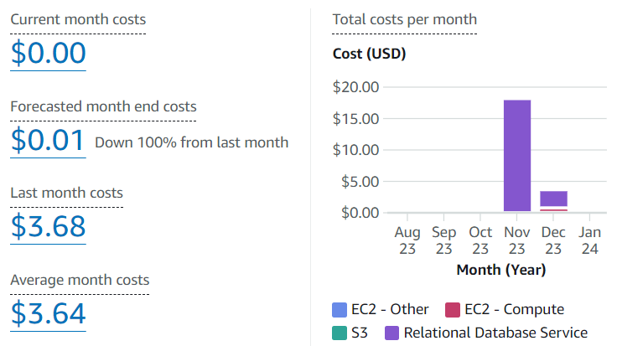
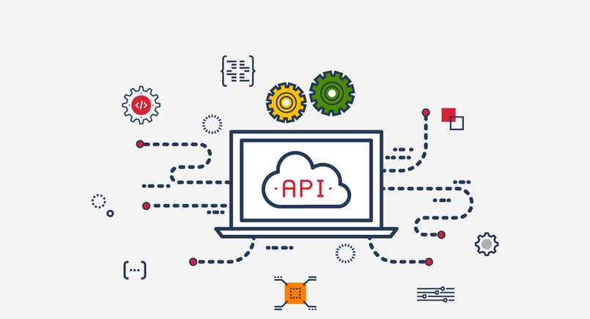
Constraints
In our AWS environment, not all services come without costs certain services like RDS, EC2, and Elastic IP Addresses require payment.
Another challenge we face involves a third-party API we use for similarity calculations. This API is not entirely within our control, and its occasional unavailability may disrupt our similarity calculation processes, potentially affecting the availability of the similarity feature system.

Slide 50

Future Works
Support time complexity calculation for the submission code of the challenge.
Support creating a challenge related to image processing.

Slide 51
Thank You !

